Slide 1



Department of Computer Science and Engineering
IT23A31 –IOT
Smart Fluid Monitoring System Using IoT and Multi-Sensor Integration for Real-Time Analysis
Bhuvaneshwari K -230701055
Deepa S-230701065

Slide 2
Problem Statement
Many people still rely on manual fluid level checks,which are often inaccurate and inconvenient.This can result in unexpected shortages,causing issues like water supply disruptions or fuel depletion.On the other hand ,overfilling can lead to wastage,spills and safety hazards.A smarter,automated solution is needed for efficient monitoring and timely alerts.

Slide 3
ABSTRACT
Water is essential for life, yet billions face challenges related to its conservation, safety, and quality. In households, industries, and agriculture, fluid mismanagement leads to waste, contamination, and potential hazards. To address this, IoT-based Smart Fluid Monitoring Systems have been developed. These systems offer a reliable and intelligent solution for real-time fluid management. Built using the ESP32 microcontroller, they integrate ultrasonic sensors, float sensors, temperature sensors, leakage detectors, and alert mechanisms like buzzers or LEDs.
The system continuously monitors fluid level, quality and leakage, offering instant alerts when abnormalities are detected. With the power of embedded sensors and wireless connectivity, it empowers users to manage fluids efficiently and securely. From detecting dangerously low levels to identifying potential leaks, the system acts proactively to prevent loss and ensure safety. By leveraging IoT, this solution helps conserve precious resources and supports the global push for sustainability. It fosters a smarter environment where technology ensures better control, informed decisions, and peace of mind for users. With innovations like this, we pave the way for responsible usage and a future where every drop counts.

Slide 4
Introduction
In a world increasingly aware of sustainability and safety, managing fluids efficiently has become more crucial than ever. The Smart Fluid Container Monitoring System emerges as a modern solution, blending IoT technology with real-time sensory intelligence. Designed with multiple sensors—ultrasonic for fluid levels, float sensors for predefined thresholds, temperature sensors for thermal monitoring, and leakage detectors for safety—the system ensures proactive fluid management.Backed by the ESP32 microcontroller and featuring auditory alerts, this smart system empowers users to monitor and manage fluids remotely and intelligently. Whether in households, industries, or agriculture, it promotes efficient resource usage, prevents waste, and detects anomalies like leaks before they become hazards.
As we confront global challenges related to water conservation and safety, such innovations pave the way for smarter living. They foster not only efficiency but also environmental responsibility, supporting a future where every drop is valued, monitored, and preserved. With smart fluid monitoring, we move closer to a world where technology enhances everyday decisions, securing both sustainability and peace of mind.

Slide 5
Proposed Work
The Smart Fluid Monitoring System integrates IoT technology with precision sensors to continuously monitor fluid levels and quality while detecting leaks, providing real-time alerts to users via wireless notifications and on-site indicators, eliminating the need for manual checks.
Using an ESP32 microcontroller as its brain, the system combines ultrasonic sensors for accurate level measurement, float sensors for threshold detection and leak detectors placed strategically around containers, all working together to prevent wastage and ensure safety.
The proposed solution empowers users with data-driven fluid management through customizable alerts and intelligent analysis, transforming reactive practices into proactive resource stewardship that prevents unexpected shortages, avoids dangerous overflow situations, and contributes to overall sustainability and conservation efforts.

Slide 6
Implementation
Relying on manual fluid checks creates risks of shortages, waste, and leaks. This IoT system uses sensors to detect fluid levels, temperature changes, and leakage in real-time, preventing costly spills and supply disruptions.
Accessing accurate fluid data empowers users to make informed decisions about resource management, maintenance schedules, and consumption patterns.
This automated solution eliminates constant manual monitoring while providing peace of mind through reliable alerts and promoting responsible resource management through data-driven insights.
With global challenges in water conservation and fluid management affecting billions, this scalable solution addresses diverse needs across residential, industrial, and agricultural applications.

Slide 7
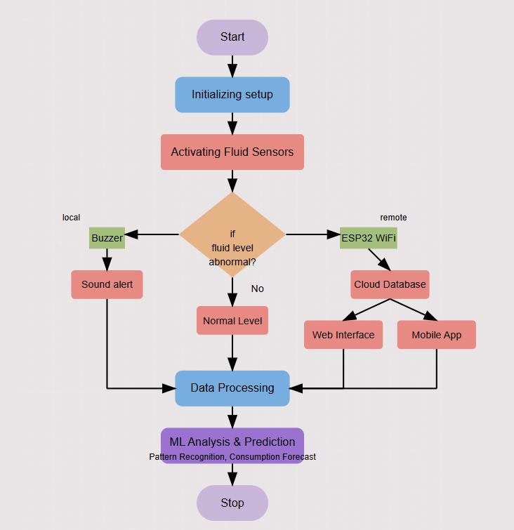
Architecture

Slide 8
System requirements
Arduino UNO software
ESP32 Microcontroller
Ultrasonic sensor
Float senor
Water leakage sensor
Buzzer
Jumper wires
Web Interface

Slide 9
Advantages of the proposed system
Prevents Overflows and Shortages
Ensures Fluid Quality and Safety
Early Leak Detection
Remote Monitoring and Alerts
Promotes Efficient Resource Management
Accessible and Scalable

Slide 10
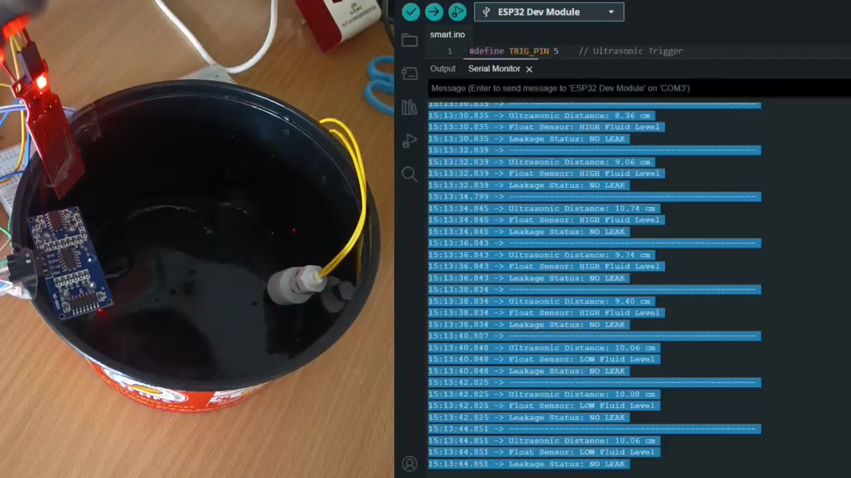
Working model

Slide 11
Implementation of Fluid monitoring
An ultrasonic sensor mounted above the fluid container measures the fluid level by calculating the time it takes for sound waves to bounce back from the fluid surface.
A float sensor detects whether the fluid level is above or below a critical threshold and sends a digital signal accordingly.
A leakage sensor placed near the container detects any unintended fluid leaks.
All sensor data is processed by the ESP32 microcontroller, which triggers a buzzer alert when low levels or leaks are detected and optionally sends data to a cloud dashboard for remote monitoring.
.
The trained model is integrated into the system to predict and alert users about potential issues, enabling smarter, proactive fluid management and reducing waste.
Sensor data is exported as CSV from the monitoring dashboard and used to train a machine learning model that learns patterns related to fluid levels, leak detection, and anomalies

Slide 12
Conclusion
We have developed an IoT-based Smart Fluid Monitoring System that continuously tracks fluid level, and leakage, offering real-time alerts to prevent fluid wastage and hazards. The system ensures efficient and reliable fluid management across various domains such as households, industries, and agriculture. Future enhancements may include integrating AI-based predictive analysis, advanced anomaly detection, and mobile notifications. With the addition of image recognition, automatic valve control, and cloud-based analytics, the system can evolve into a fully autonomous and intelligent fluid management solution.

Slide 13
References
[1] N. Saeidi, K. Selvam, F. Tortato, M. Wiemer, and H. Kuhn, "High Precision Liquid Level and Leak Detection Based on Capacitive Micromachined Ultrasound Transducer," IEEE Sensors Symposium, 2022, doi: 10.1109/SSI56489.2022.9901430.
[2] D. S. Bhandare, V. S. Jape, H. H. Kulkarni, S. M. Mahajan, P. Sable, Y. Pawar, "Automatic Liquid Level Control of Two Tank System using PLC," IEEE International Conference on Intelligent Systems and Automation (ICISAA), 2024, doi: 10.1109/ICISAA62385.2024.10828622.
[3] X. He, Y. Ma, T. Li, Q. Sun, Q. Feng, "Real-Time Liquid Level Monitoring With Low-Cost UHF RFID Sensors," IEEE Sensors Journal, 2025, doi: 10.1109/JSEN.2025.3528128.
[4] S. S. Gondkar, D. B. Pardeshi, P. W. William, "Innovative System for Water Level Management using IoT to prevent Water Wastage," IEEE International Conference on Advances in Computing and Artificial Intelligence (ICAAIC), 2022, doi: 10.1109/ICAAIC53929.2022.9792746.
[5] N. R. Gayathri, S. Manjula, W. T. Chembian, V. Dhivya, K. R. Anirudh Dhanunjay, "Smart Water Quality Monitoring and Management System," IEEE International Conference on Power Electronics and Communication Technology (ICPECTS), 2024, doi: 10.1109/ICPECTS62210.2024.10780355.

Slide 14
Thank You

